Slide 1

Nosotras somos pyladies en Arequipa
Eloisa Paredes lizeth.pareca@gmail.com

Slide 2

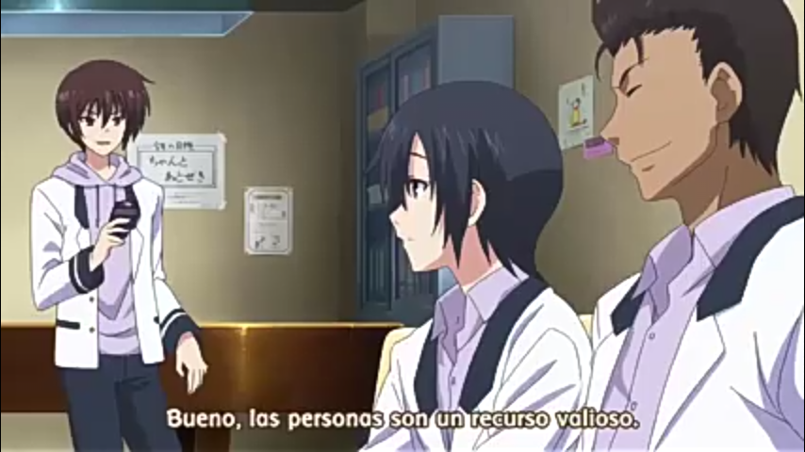
Conozcamos un poco
Yo soy …
Me gusta …
No me gusta …

Slide 3
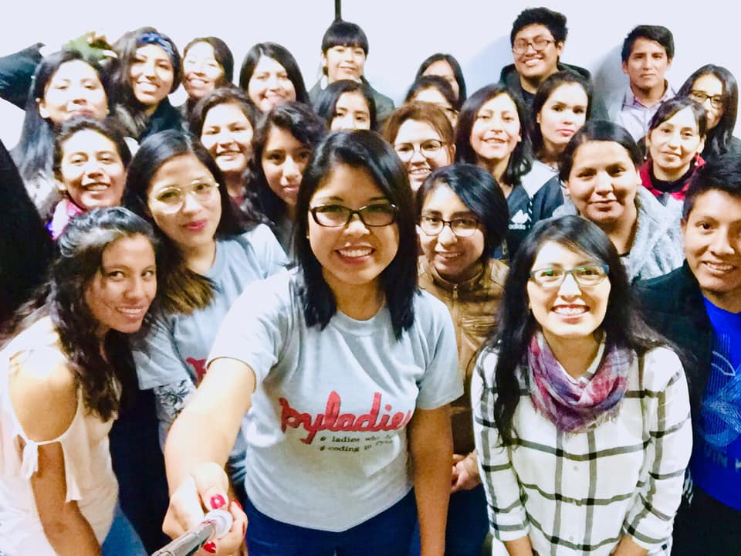
Hello!

Slide 4
Por qué aprender Python?
1
…

Slide 5
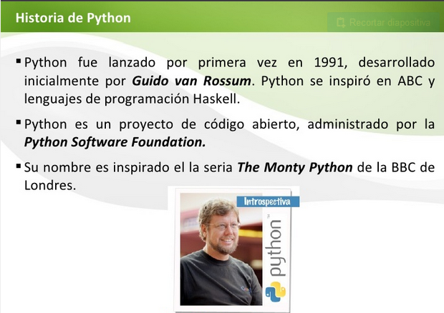
This is a slide title
Here you have a list of items
And some text
But remember not to overload your slides with content
Your audience will listen to you or read the content, but won’t do both.
Fuente: Jesse Padilla Agudelo - SlideShare

Slide 6
Qué es Python?
1
Es un lenguaje de alto nivel, e interpretado.
Y muchas otras caracerísticas.

Slide 7
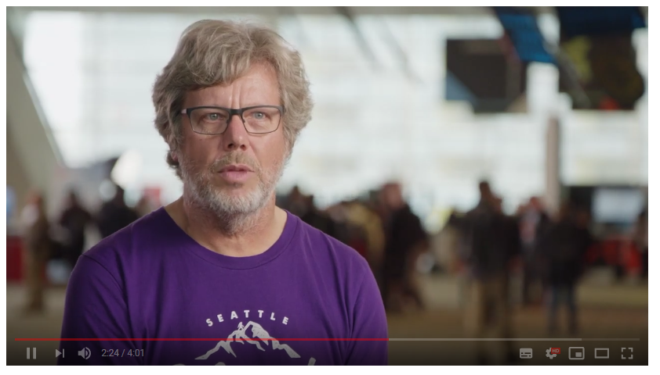
The Story of Python, by Its Creator, Guido van Rossum
https://www.youtube.com/watch?v=J0Aq44Pze-w

Slide 8
Por qué aprender Python?
1
…

Slide 9



Aplicaciones hechas con Python
Instagram
Pinterest
Battlefield 2

Slide 10
Aplicaciones hechas con Python
"La NASA también utilizó Python en el desarrollo de OpenMDAO, herramienta para resolver problemas de optimización de diseños multidisciplinarios y es un claro ejemplo de que con Python, las estrellas son el límite”.

Slide 11
Quotations are commonly printed as a means of inspiration and to invoke philosophical thoughts from the reader.

Slide 12
Big concept
Bring the attention of your audience over a key concept using icons or illustrations

Slide 13
You can also split your content
White
Is the color of milk and fresh snow, the color produced by the combination of all the colors of the visible spectrum.
Black
Is the color of coal, ebony, and of outer space. It is the darkest color, the result of the absence of or complete absorption of light.

Slide 14
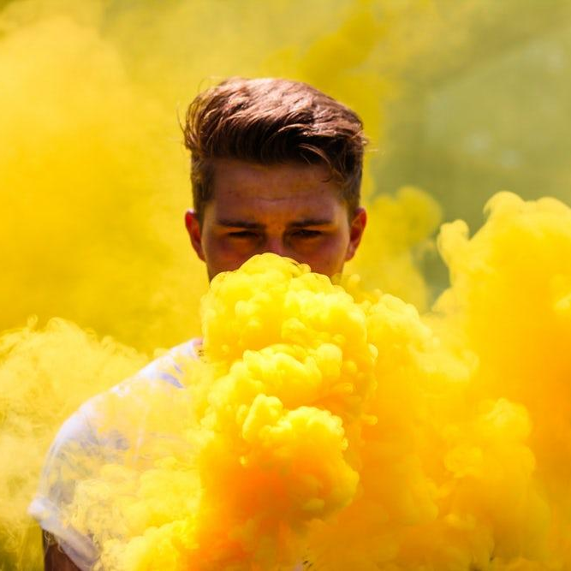
A picture is worth a thousand words
A complex idea can be conveyed with just a single still image, namely making it possible to absorb large amounts of data quickly.

Slide 15
And tables to compare data
 | A | B | C
Yellow | 10 | 20 | 7
Blue | 30 | 15 | 10
Orange | 5 | 24 | 16

Slide 16
89,526,124
Whoa! That’s a big number, aren’t you proud?

Slide 17



Gracias!
Any questions?
Pyladies Arequipa
Github: PyladiesAqp
Pyladies Arequipa
aqp@pyladies.com

